Slide 1
Q-Learning vs. DQN
Comparing learning algorithms on Atari game Space Invaders
By Divyam Garg & John DiNofrio

Slide 2

Reinforcement Learning
Reinforcement learning is one of the three most basic machine learning techniques
Unlike supervised and unsupervised learning
It does not require labeled data
It does not need to directly correct every action
By setting positive and negative rewards, the program can teach itself how to play games or perform actions

Slide 3
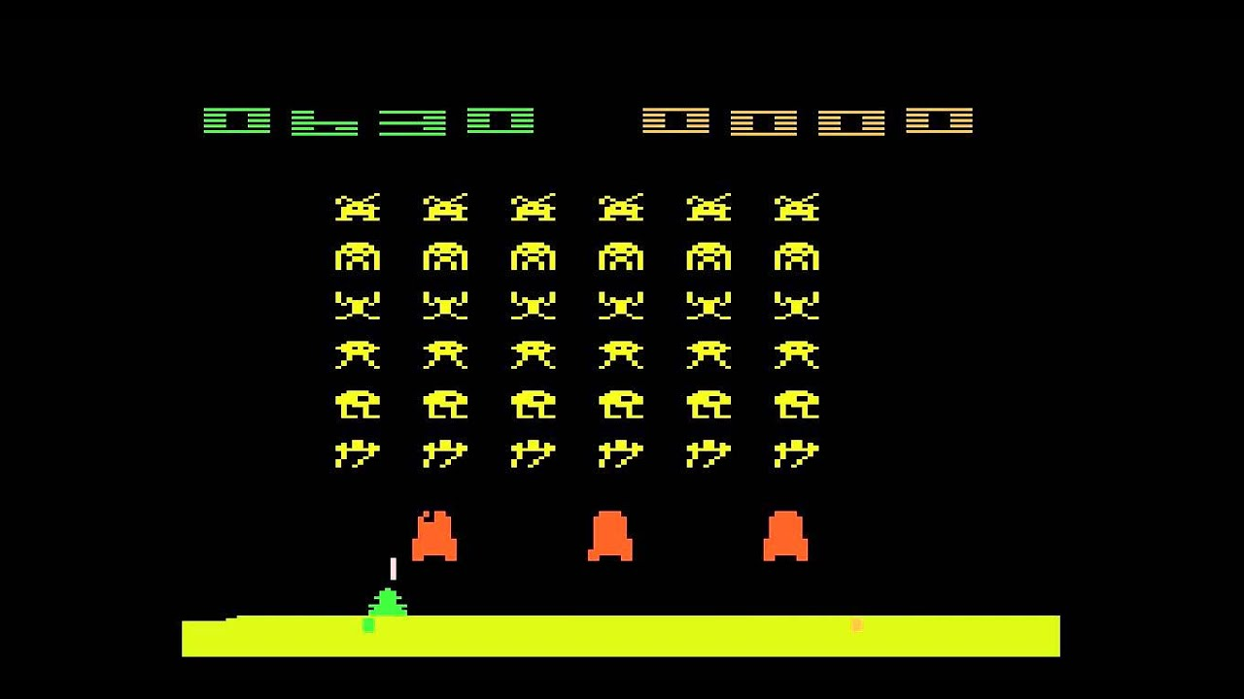
Space Invaders
We used it to teach the computer how to play the Atari game Space Invaders
We used both Q-Learning
and DQN to demonstrate
this and compare how the
two methods worked

Slide 4
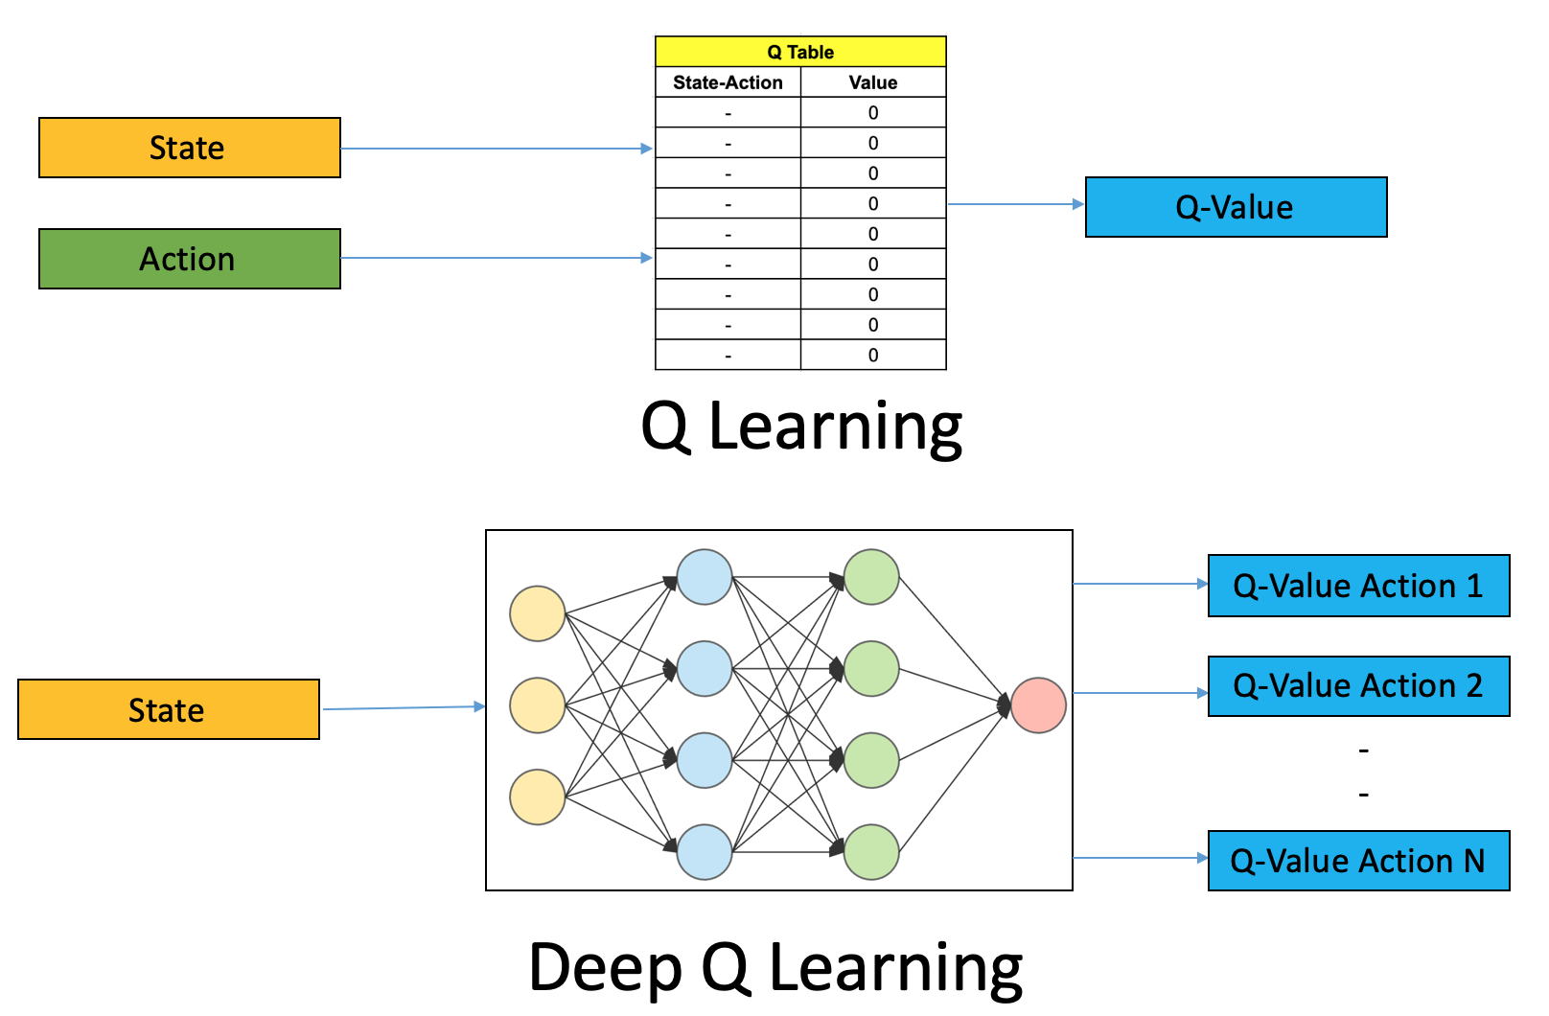

Slide 5
Q-Learning
Q-Learning is quite simple to implement
The entire algorithm depends on an array called a Q-Table
This Q-Table is n x m dimensions
Where n is the number of actions possible
Where m is the number of states possible
For every current state and action that led it there, the value in the Q-Table will change
The value will go up if the reward was positive for that action
The value will go down if the reward was negative
The value could go up or down if there is no reward - this depends on the parameters you set

Slide 6
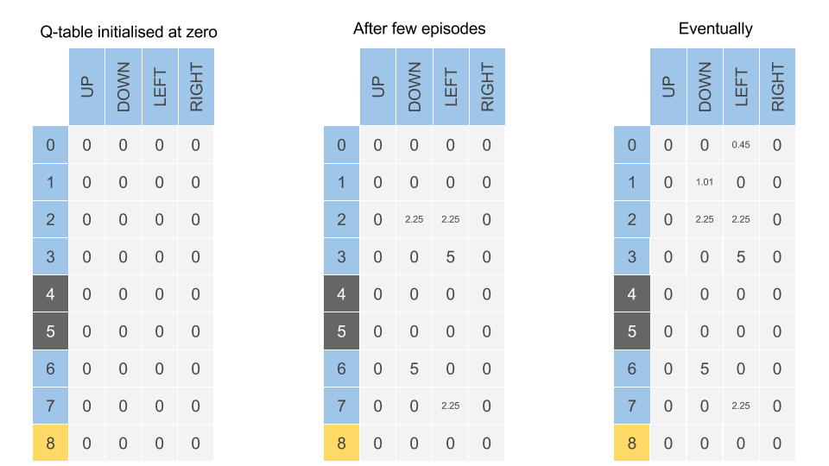

Slide 7
Q-Learning
For both Q-Learning and DQN, there are certain parameters you can set
Learning rate - how much new data overwrites old data
0 = no learning 1 = only new info is retained
Discount rate - short term or long term goals
0 = short-sighted 1 = far-sighted
Exploration rate - how often the program tries random, new actions
0 = never 1 = always new and random
Number of episodes - the amount of attempts it gets (how many games)
Number of steps - the number of actions it can take per episode

Slide 8
Q-Learning on Space Invaders
Learning rate - 0.3
Discount rate - 0.7
Exploration rate - Started at 1 and exponentially went down
Number of episodes - the amount of attempts it gets (how many games)
Number of steps - Max 50000
Action space - 6 (move left, move right, shoot, move left/shoot, move
right/shoot, do nothing)
State space- 160 (width of game)

Slide 9
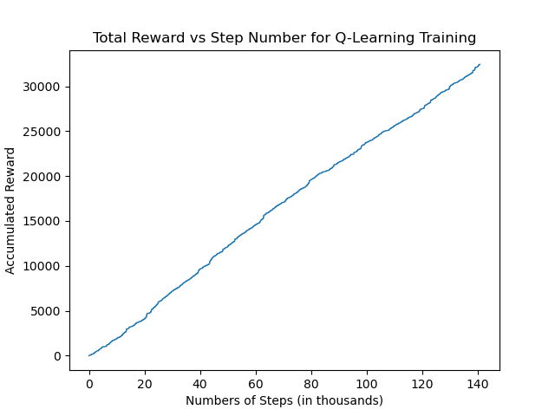
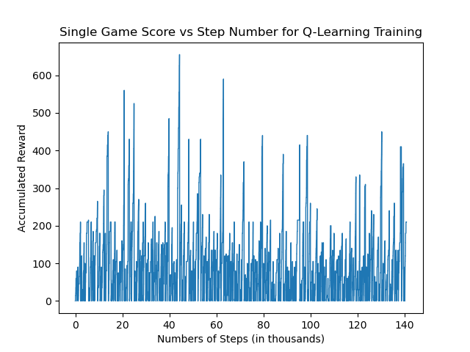
Q-Learning Training
200 Episodes

Slide 10
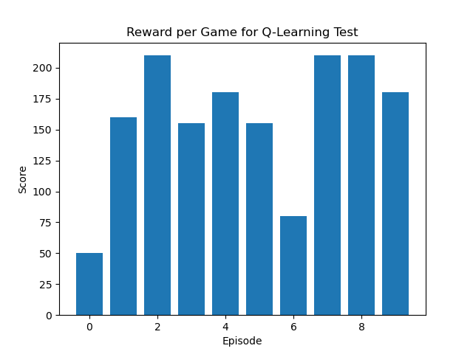
Q-Learning Test
200 Episodes

Slide 11
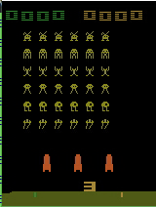
Q-Learning Test
200 Episodes
Score 50.0
Score 160.0
Score 210.0
Score 155.0
Score 180.0
Score 155.0
Score 80.0
Score 210.0
Score 210.0
Score 180.0
Average Score: 159.0

Slide 12
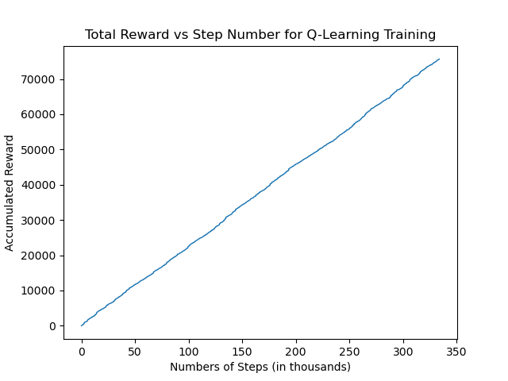
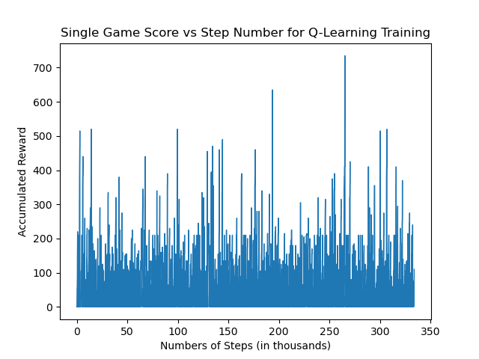
Q-Learning Training
200 Episodes

Slide 13
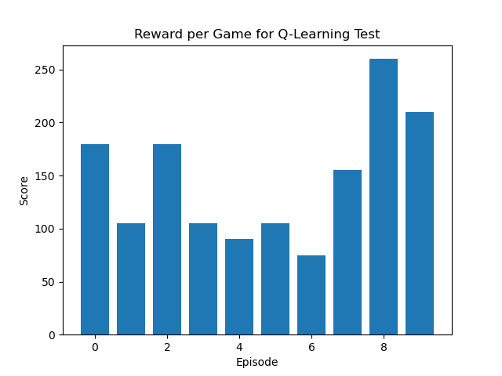
Q-Learning Test
200 Episodes

Slide 14
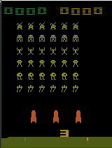
Q-Learning Test
500 Episodes
^{Score 180.0}
^{Score 105.0}
^{Score 180.0}
^{Score 105.0}
^{Score 90.0}
^{Score 105.0}
^{Score 75.0}
^{Score 155.0}
^{Score 260.0}
^{Score 210.0}
^{Average Score: 146.5}

Slide 15
Q-Learning Results
Unfortunately, the Q-Learning algorithm did not perform very well. It learned the basics and could get a few points in before it died, but it didn’t play the game
The reason for this is the state space
The state space for Q-Learning was the position of the spaceship
It had no idea where the bullets or ships were
What it did learn
With the little information it had, it knew that it wouldn’t get hurt while hiding under the shield
It also knew that if it kept shooting with half its body protected away it could get the most points
Q-Learning doesn’t have the capacity to process that much information and fine two its training

Slide 16
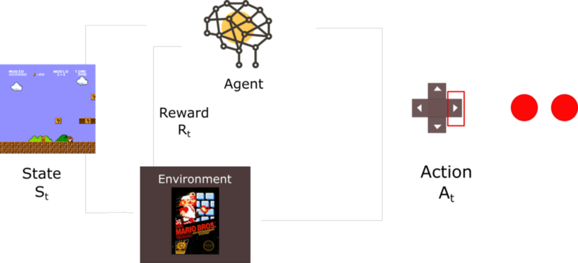
Overcoming Shortcomings with Deep - Q Learning
The problem with games is that the agent must take in images as perception; therefore, we need to use a convolutional neural network to add precision.
The state space for DQN is a lot bigger, and it includes every pixel on the screen
This means that DQN knows where every bullet and enemy is as well as how much shield is left

Slide 17
Implementation of Deep Q-learning Algorithm
Initialize the environment of the Space-Invaders-Atari 2600 (8 actions possible)
Preprocessing the frame:
Removal of unnecessary pixel (210,160) to (110,84)
Normalise for better distribution and resizing the image
Getting stack frames
Setting up training and hyper-parameters (state size : - 110,84,4)
Learning rate: - 0.0025 & decay rate = 0.0001
Total episodes = 150
Batch size = 64
Explore probability at start = 1.0
Discount = 0.9
Memory size = 1000000

Slide 18
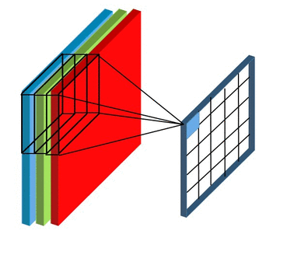
Making it work
Pre-Processing the frame
Adding 4 frames/state as a single experience in a stack format
Memory: - Storing previous experiences
Replay Buffer: - Avoid reinforcing the same experience (overfitting) and making previous experiences more efficient.
Creating the hidden layers
3 Conv2d layers activation = ‘elu’
flatten
2 Dense layers activation = ‘softmax’
Output layer size = action set (8)

Slide 19

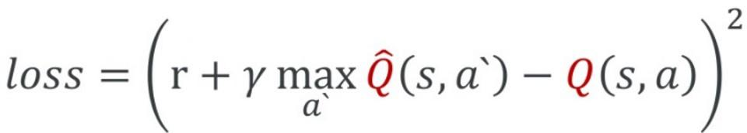
Making it Work
Exploration :- explore_start = 1.0 and explore_stop = 0.01
explore_probability = explore_stop + (explore_start - explore_stop) * exp(-decay_rate * decay_step)
Target networks and Loss Function

Slide 20
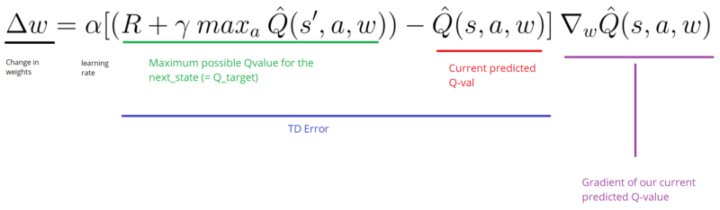
Deep Q- learning training

Slide 21
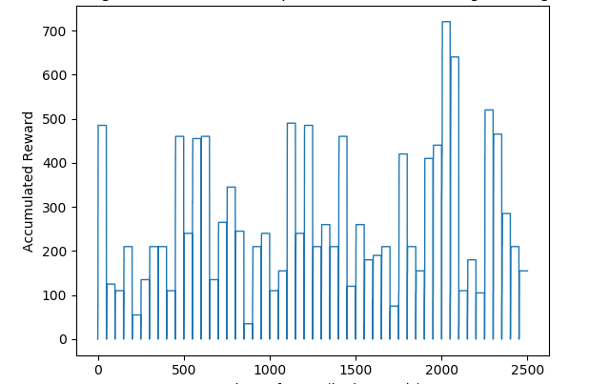
DQN Training - 50 Episodes
Score per Game - DQN Training
Numbers of Steps (in thousands)

Slide 22
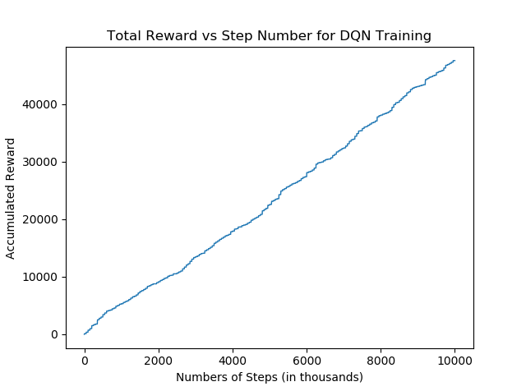
DQN Training (200 Episodes) vs Q-Learning (500 Episodes)

Slide 23
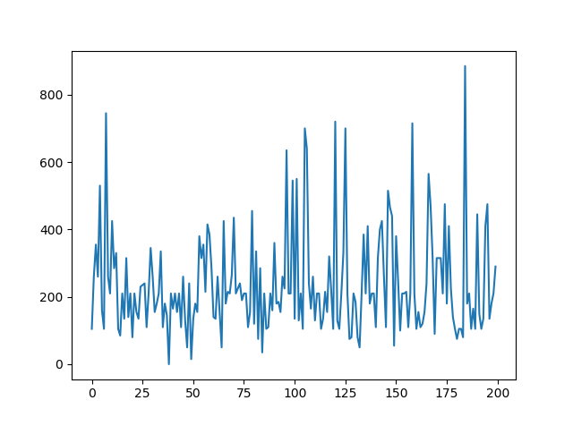
DQN Results - Training 200 Episodes/Test 10 Games
Score per Episode DQN Training
^{Score 480.0}
^{Score 520.0}
^{Score 260.0}
^{Score 405.0}
^{Score 190.0}
^{Score 855.0}
^{Score 630.0}
^{Score 345.0}
^{Score 305.0}
^{Score 225.0}
^{Average Score: 394.0}
Score
Episode

Slide 24
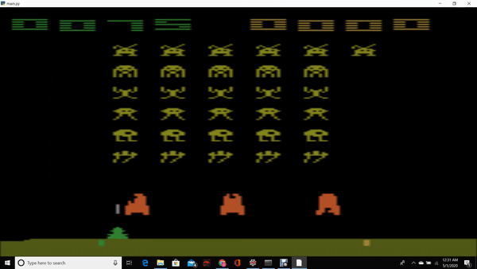

Slide 25
DQN Results
DQN performed a lot better than Q-Learning did, but it took a lot more time to train
Top Score - 855 (compared to Q-Learning’s 260)
Avg Score - 394 (compared to Q-Learning’s 146)
With a very large state space, DQN could find the best move for every scenario
This also meant that the training time was a lot longer
Training just 50 episodes took almost 3 hours
Training 50 episodes with Q-Learning only took about 10 minutes
The DQN algorithm performed much better when we gave it more time to train
Q-Learning had a lot fewer steps (by a factor of 100) but a lot more episodes (300 more episodes), and it still did not do as well
When it comes down to it, DQN actually played the game
It knew where to hide, when to shoot, and the pink think at the top is bonus points
Q-Learning had no clue about any of that except how to hide

Slide 26
Code
Use this link to access out GitHub
https://github.com/johndinofrio/ENPM690_Final_Project.git

Slide 27
References
https://www.freecodecamp.org/news/an-introduction-to-reinforcement-learning-4339519de419/
https://simoninithomas.github.io/Deep_reinforcement_learning_Course/
https://yilundu.github.io/2016/12/24/Deep-Q-Learning-on-Space-Invaders.html
https://www.youtube.com/watch?v=PnHCvfgC_ZA&list=PL7-jPKtc4r78-wCZcQn5IqyuWhBZ8fOxT&index=4
https://www.youtube.com/watch?v=0g4j2k_Ggc4&list=PL7-jPKtc4r78-wCZcQn5IqyuWhBZ8fOxT&index=5
https://www.youtube.com/watch?v=gCJyVX98KJ4

